Slide 1
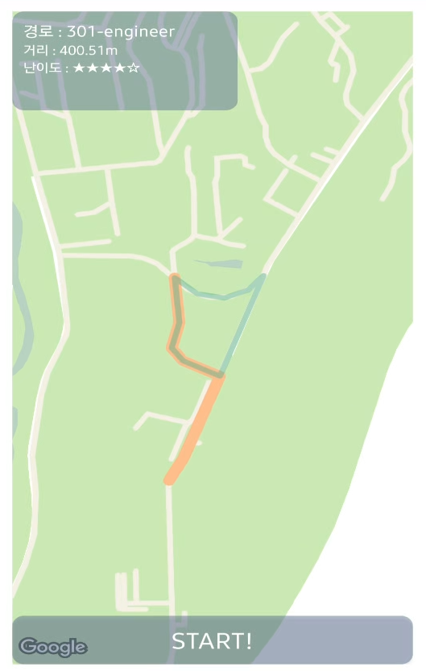
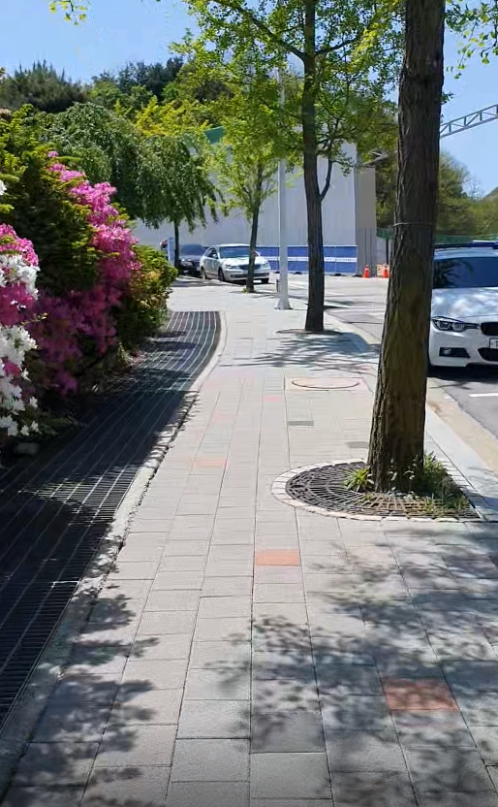

Title
Course
Walking
Result
Confirmed
Permission
Well done!
Confirmed
Course
Finished
Walking
Walking
Friend
Go back
Paused
Permission
Denied
Pause
Reset Course
Paused
Paused
Go to title
Go to title

Slide 2
Title Screen
Check & Ask permissions
Ask to turn on GPS
Download data
Walking
Friend
Start!

Slide 3

Course
Recommend courses based on Google map
Let player to select course

Slide 4
Walking
Walk with ‘friend’
Detect objects to collect score
Scene classification to show different interaction
It’s that
a flower?
3.5 km / h
01 : 20

Slide 5
Result
Show Scores
Go back to title
Well done!
How was today’s
stroll?
Course Level
Ave. Speed
3.3 km / h
Total time
20 min
Return to title

